Slide 1
CENG 317 Presentation
Link to github repository
https://github.com/Manshur7/Capstone-Project

Slide 2
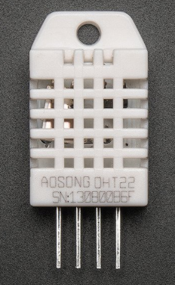
Project Proposal
Reasons for choosing Lumi Monitor Project :
Way of implementing a wide range of Sensors
Would be helpful for parents to monitor conditions for their children as well as means of communication
Proposed Features:
Temperature & Humidity tracking
Light Level Monitoring (And Automation)
Communication Line between child and parent
DHT22 Sensor:

Slide 3
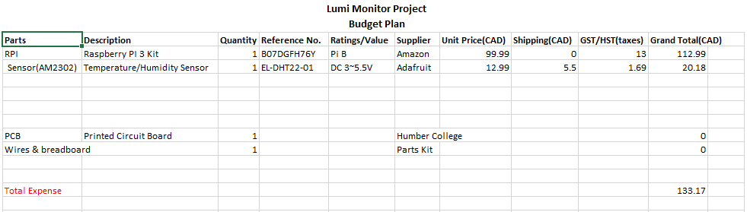
Project Budget
Initial Budget Planning:
Later on, screws & spacers for mounting the case were bought from Amazon for $15

Slide 4
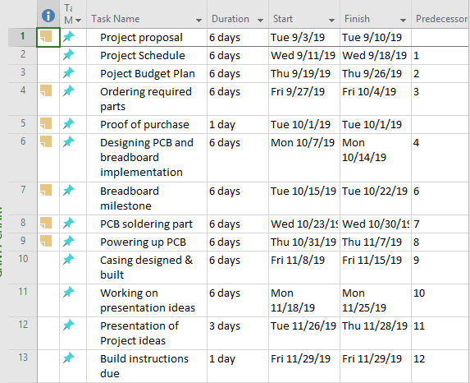
Project Schedule
Created using Microsoft Project Planner

Slide 5
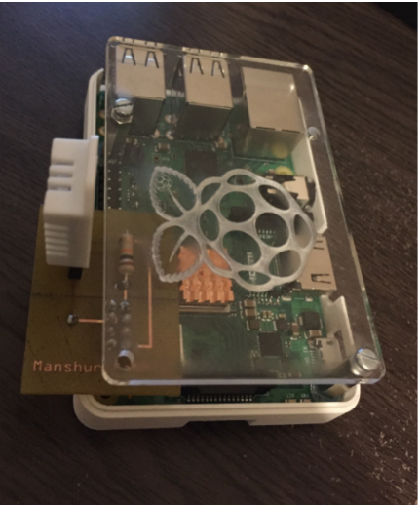
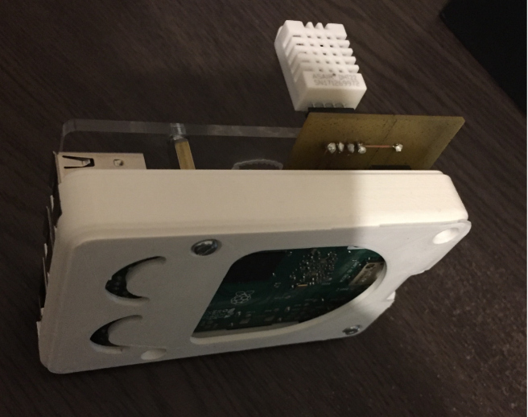
Final Product
Below are 2 pictures of the final enclosed Hardware
3D printed Bottom & Acrylic Top:

Slide 6
Knowledge from CENG courses
Personally, I feel like that these 2 courses were majorly involved:
CENG 252: Embedded Systems
Mostly relevant as it involved using a development platform with Sensors/Effectors
Moreover, I was able to learn the basics of how an integrated System works in real time
Also learnt how to use remote desktop connection to access a development platform
CENG 216: Intro to Software Engineering
Project planning and implementation
Taught me how to use various tools such as: Gantt Charts, Argo UML (For UML diagrams)
Also helped to have a clear idea of what a project implementation is like (For example: Which techniques to use to stay on track and follow critical path.)

Slide 7
THANK YOU for your attention

